Slide 1
Grants and Proposal Writing
March 21, 2017

Slide 2
Mark Robinson
Associate Director of Institutional Support, Catholic Education Advancement
Inner-City Scholarship Fund
Champions for Quality Education

Slide 3
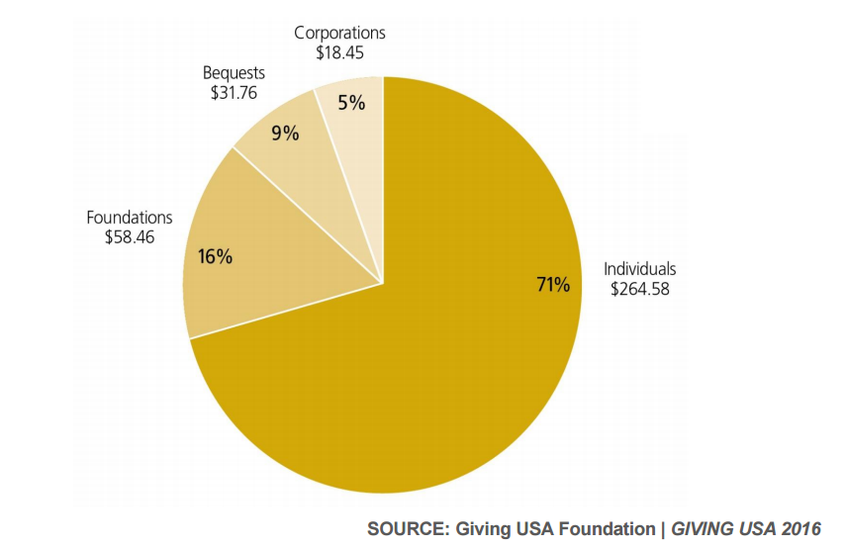
Private Contributions by Source
Total Giving: $373.4
($ in billions)

Slide 4
Types of Grantmaking Institutions
Private Foundations
Independent
Company-sponsored
Direct Corporate Giving Programs
Grantmaking Public Charities

Slide 5
Before you begin, here’s what you’ll need…
501(c)(3) status
Letter of Determination from the IRS
990-PF
Audited financial statements
Capable leadership
Board
Staff

Slide 6
Things to note…
The grant-seeking process takes time
Project/program-based funding is the most appealing to funders, rather than general operating support
Aim for a multitude and diversity of funding sources
Grant writing does not take place in a vacuum

Slide 7
The Grants Process
Research – Identifying funders
Developing the Proposal
Follow-Up – Making contact
Stewardship – Grant reports, site visits

Slide 8
Resources for Grant Seekers
Where to search for funders…
Foundation Center
Foundation Directory Online
FADICA
(Foundations And Donors Interested in Catholic Activities)
Guidestar

Slide 9
Resources for Grant Seekers
Staying “in-the-know”…
Philanthropy News Digest (PND)
GrantWatch
Chronicle of Philanthropy
Philanthropy Roundtable

Slide 10
Resources for Grant Seekers
Using your contacts…
Relationship Science
relsci.com
Muckety

Slide 11
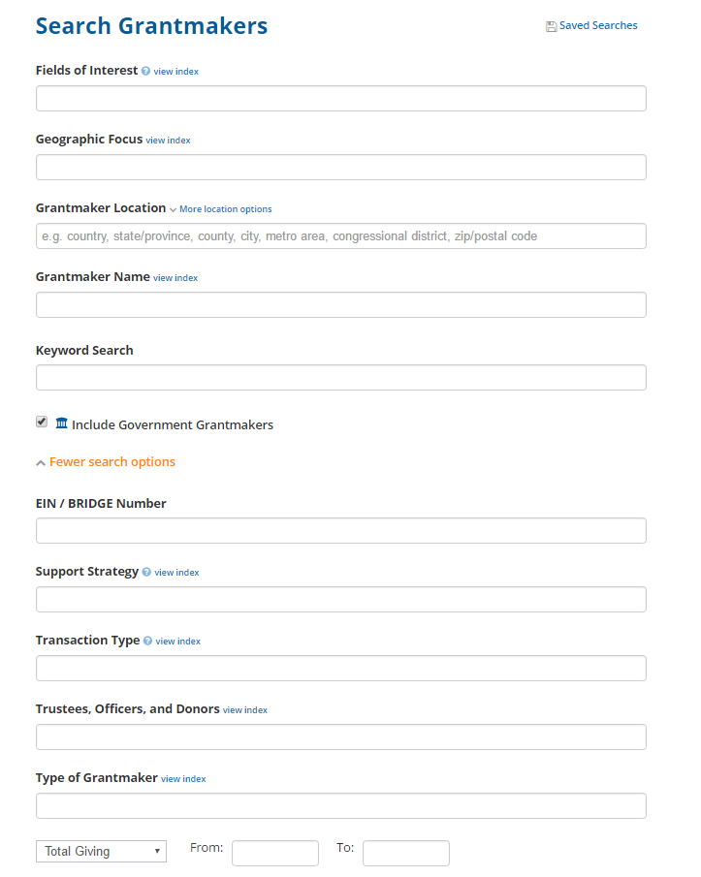
Foundation Center – Foundation Directory Online
Search Form

Slide 12
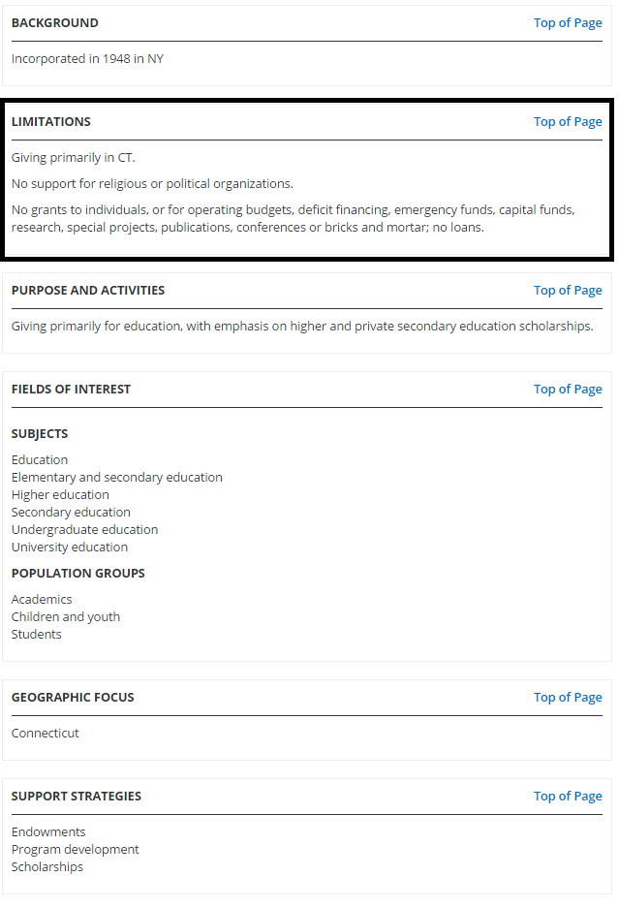
Foundation Center – Foundation Directory Online
Foundation Profile

Slide 13
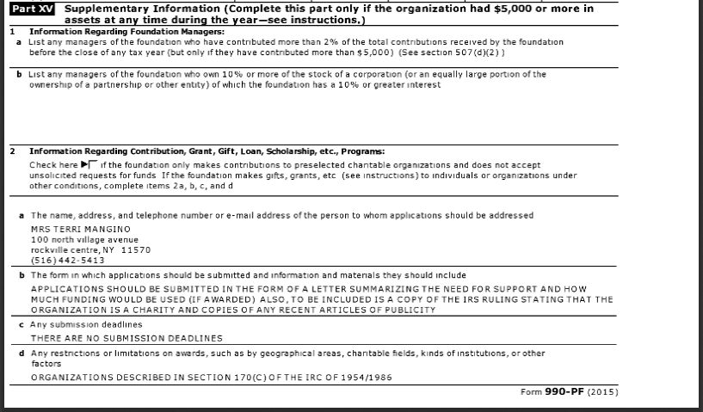
Getting to Know the 990-PF

Slide 14
Reaching Out to Funders
Step 1: Letter of Inquiry
Step 2: Proposal

Slide 15
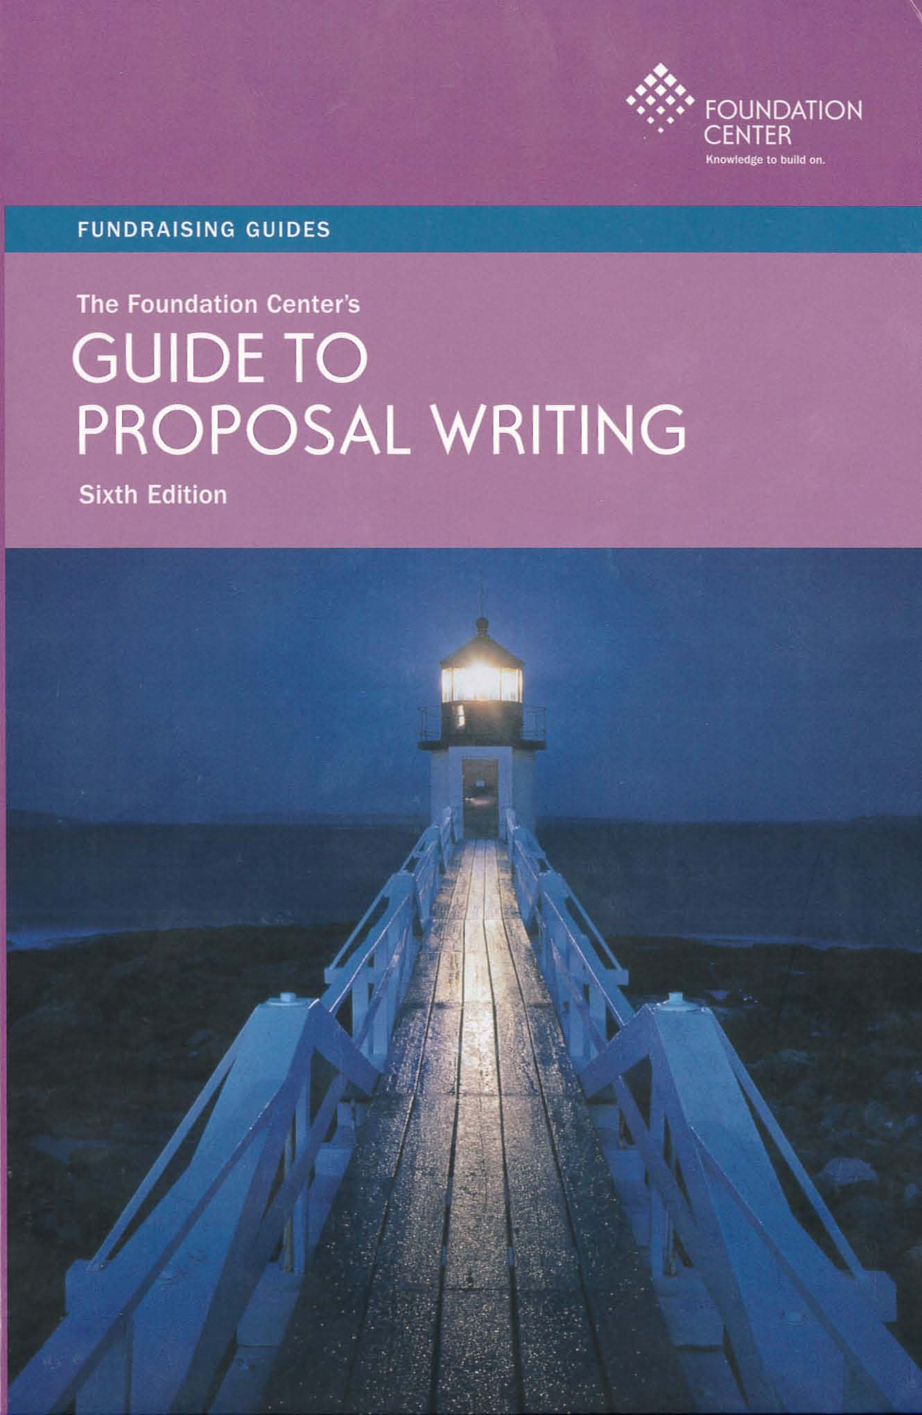
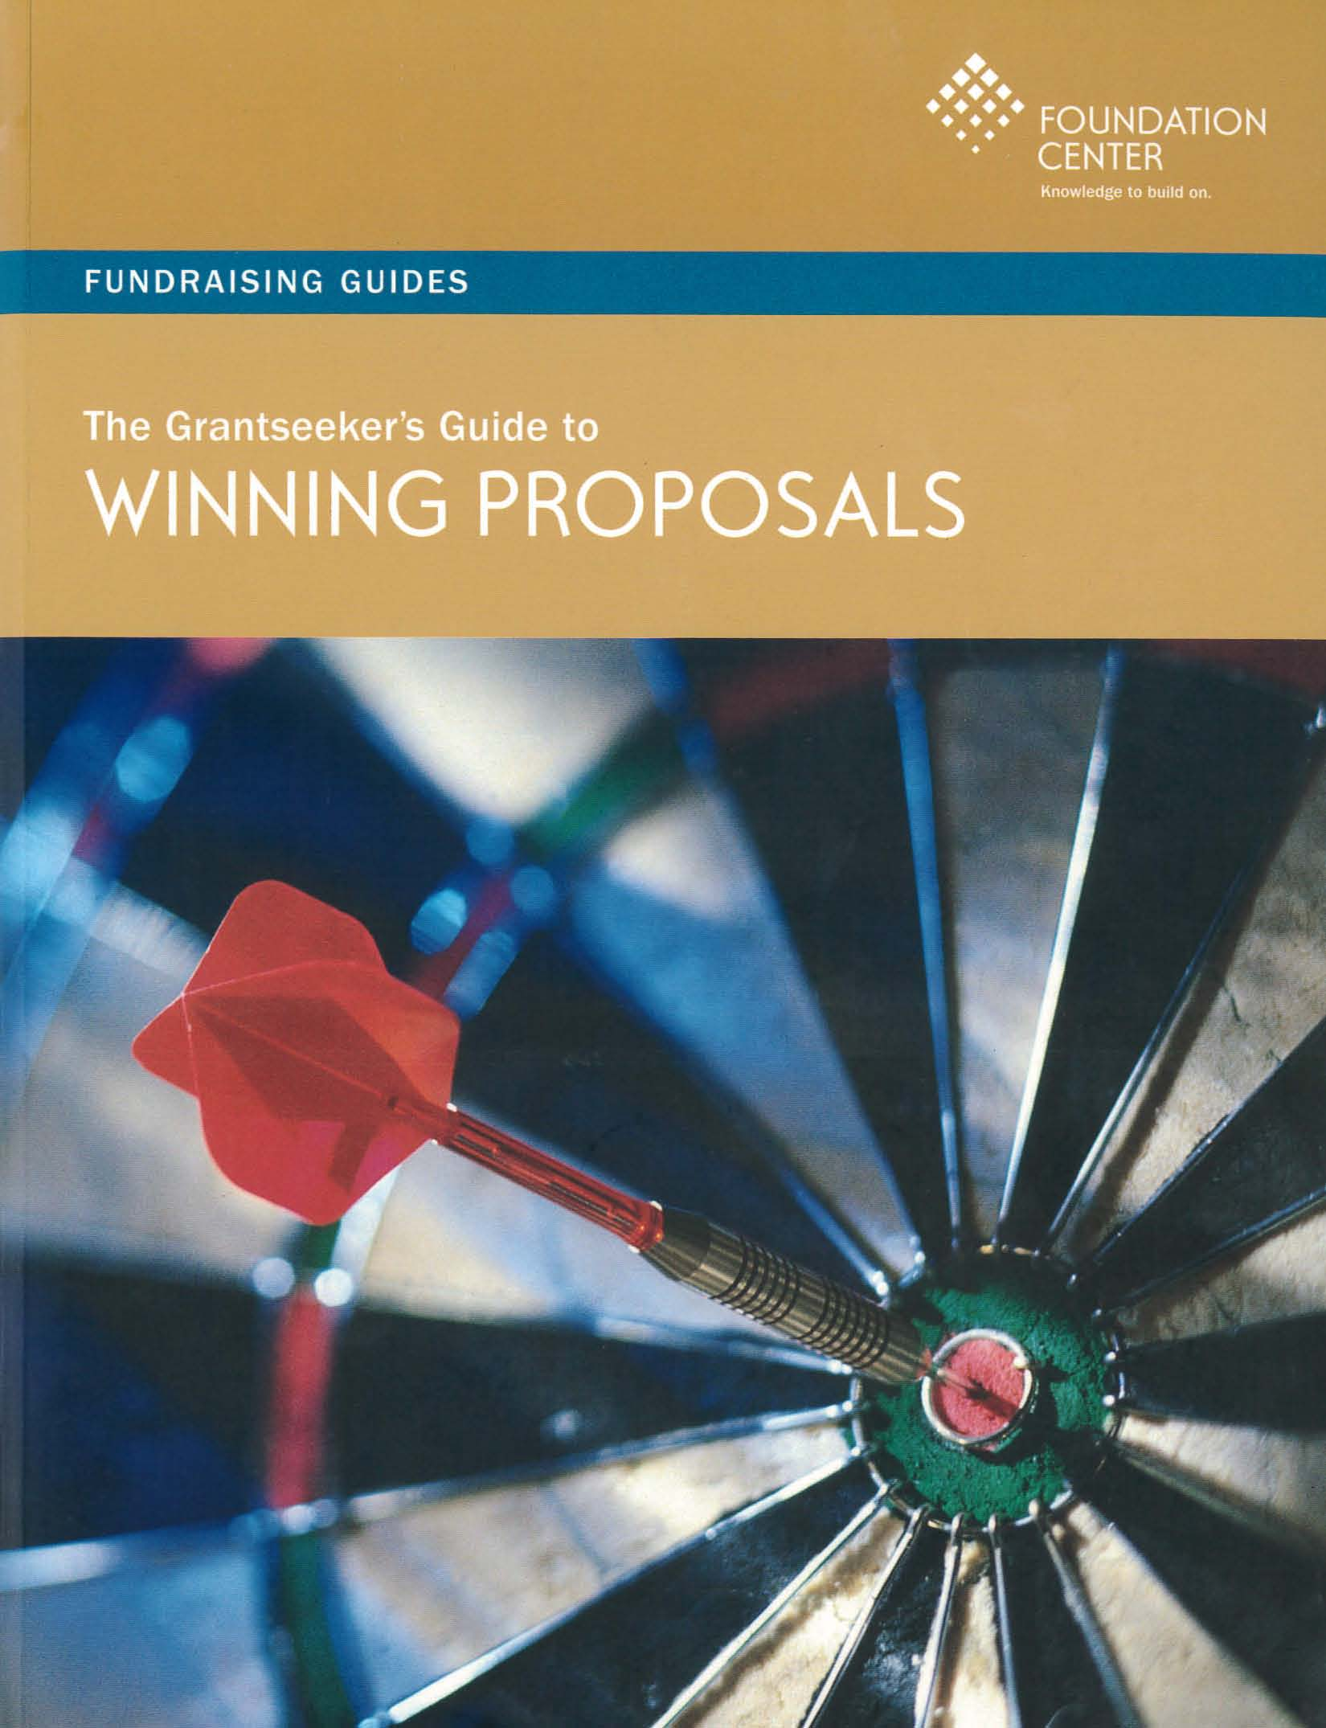
Resources for Grant Writers

Slide 16
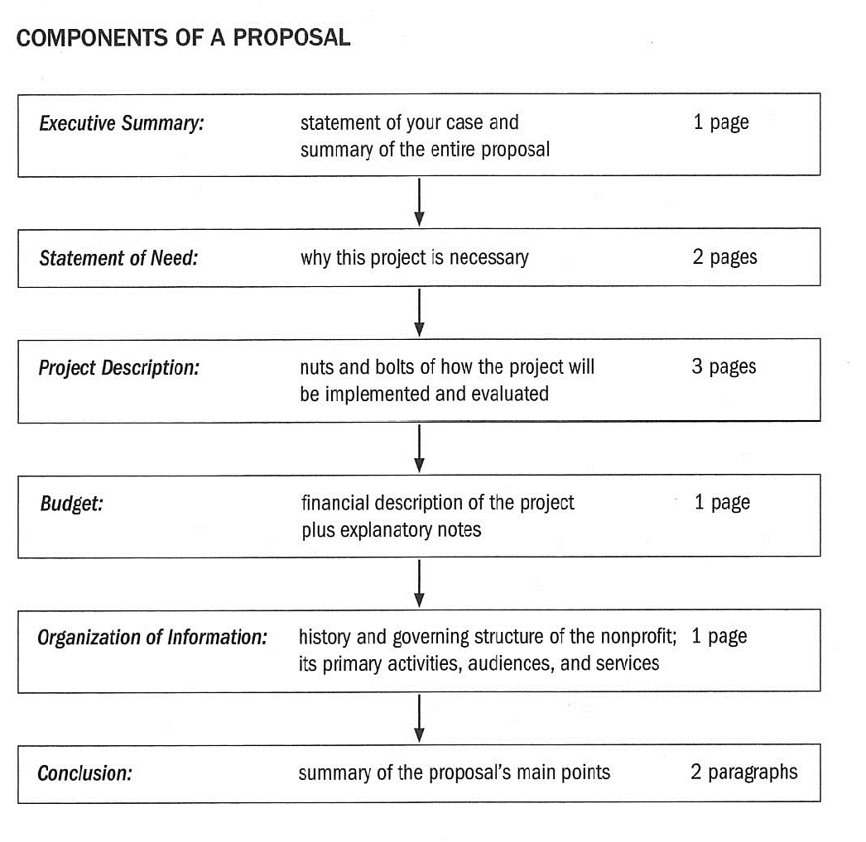
Source: The Foundation Center’s Guide to Proposal Writing, Sixth Edition

Slide 17
Follow-Up
Put a face and/or voice to your proposal…
Try to place a phone call 10 days after submitting a letter or proposal
Invite foundation officers/staff for a site visit or an in-person meeting or conference call including your fellow program staff

Slide 18
Stewardship
What happens after you get the grant…
Send progress reports
Cultivate a personal relationship with foundation officers and staff

Slide 19
Thank you!
Questions?

